Slide 1
ELECTRONIC MAIL

Slide 2
E-MAIL
Email is an electronic way to send or retrieve personal or business-related messages, including text and pictures.
E-mail system consists of two parts
User agents, which allow people to read and send email.
Message transfer agents, which move the messages from source to destination.

Slide 3
Email Protocols
Email is delivered through a client/server architecture.
An email message is created using a mail client program.
This program then sends the message to a server.
The server then forwards the message to the recipient’s email server, where the message is then supplied to the recipient’s email client.
To enable this process, a variety of standard network protocols are used;
The most commonly discussed protocols used in the transfer of email
Mail transport protocols(SMTP).
Mail access protocols(POP, IMAP).

Slide 4
SMTP
The primary purpose of SMTP is to transfer email between mail servers.
The client sends the message to an outgoing mail server, which in turn contacts the destination mail server for delivery.
It is necessary to specify an SMTP server when configuring an email client.
It does not require authentication.
It uses Transfer control protocol.
The three phases of transfer are;
Handshaking(Greeting).
Transfer of messages.
closure.

Slide 5
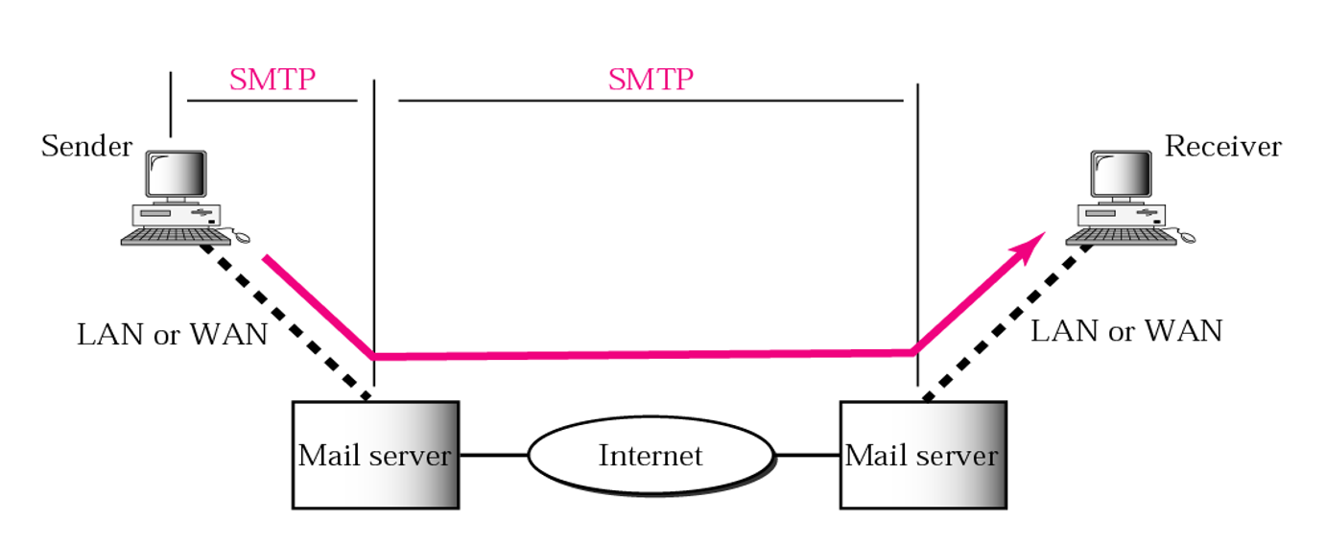
SMTP

Slide 6
Mail Access Protocols
There are two primary protocols used by email client application to retrieve email from mail servers are;
Post Office Protocol(POP).
Internet Message Access Protocol(IMAP).
Authentication is required.

Slide 7
POP3
Mail access starts with the client whr the user needs to download email from the mailbox on the mail server.
The client opens a connection to the server on TCP port 110.
It sends its username and password to access the mailbox.
The user can then list and retrieve the email messages, one by one.
POP3 has two modes: the delete mode and the keep mode. In the delete mode, the mail is deleted from the mailbox after each retrieval.
In the keep mode, the mail remains in the mailbox after retrieval.

Slide 8
IMAP(Internet Mail Access Protocol)
IMAP is similar to POP3, but it has more features. IMAP4 is more powerful and more complex.
A user can check the email header prior to downloading.
A user can partially download email.
A user can create, delete, or rename mailboxes on the mail server.
A user can create a hierarchy of mailboxes in a folder for email storage.

Slide 9
POP vs IMAP
POP3 is deficient in several ways
POP3 does not allow the user to organize her mail on the server
POP3 does not allow the user to partially check the contents of mail before downloading
With IMAP4, the user can check the email header prior to downloading
With IMAP4, the user can search the contents of the email for a specific string of characters prior to downloading
With IMAP4, the user can partially download e-mail

Slide 10
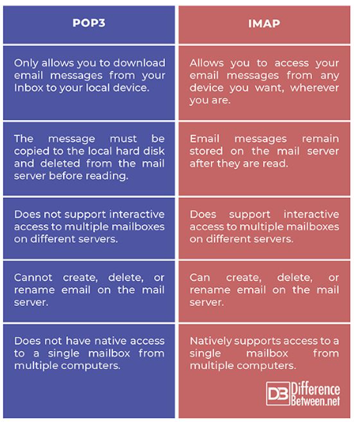
POP vs IMAP

Slide 11
Format
HEADER
Header is the area in which you enter important information above the email content area. The information in the header includes such things as the recipient, the sender, and a subject line with the option of sending copies to additional recipients.
BODY
The message body comes after the header. The user can put whatever they want to send in the message body. It is possible to terminate the messages with ASCII cartoons, quotations, and political statements.

Slide 12
Headers
Headers | Meaning
To- | Email address of primary recipients.
Cc- | Email address of the secondary recipients.
Bcc | Email address for blind carbon copies.
From- | Person who created the message.
Sender | Email address of the actual sender.
Received | Line inserted by each transfer agent along the route.

Slide 13
THANK YOU
…

